Slide 1
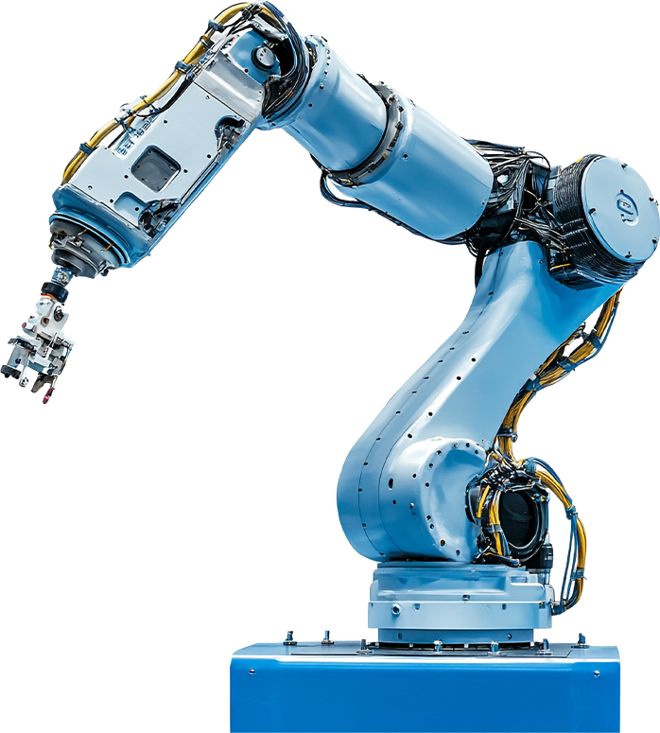
ASSISTIVE ROBOTIC ARM PROJECT
Phase 1: Planning Presentation and
Requirements Gathering Presentation
Assistive Robotics Arm Group
Supervisor: Dr. Griffith Selorm Klogo

Slide 2
PROJECT BACKGROUND
Assistive robotic arm to support people with limited mobility
Table-top arm for household pick-and-place tasks
Controlled via joystick and voice commands

Slide 3

PROBLEM STATEMENT
Individuals with physical impairments struggle with reaching and moving objects
Need for affordable, easy-to-use assistive devices
Project aims to improve independence and quality of life
.

Slide 4
PROJECT OBJECTIVES
Design a functional robotic arm prototype
Implement joystick-based manual control
Implement voice-command control using Raspberry Pi
Demonstrate safe pick-and-place operation

Slide 5
SCOPE OF THE PROJECT
In Scope:
Out of Scope:
Small household objects
Table-top environment
Arduino + servo motor control
Industrial heavy lifting
Full AI vision tracking
Medical-grade certification

Slide 6

Technical:
Arduino controls servos effectively
Raspberry Pi supports speech recognition
Financial:
Estimated budget: GHS 2,150 - 2,500
Time:
Achievable within two semester

Slide 7
USERS
People with limited mobility
Elderly individuals
Stroke Patients
Hospitals
.
.

Slide 8
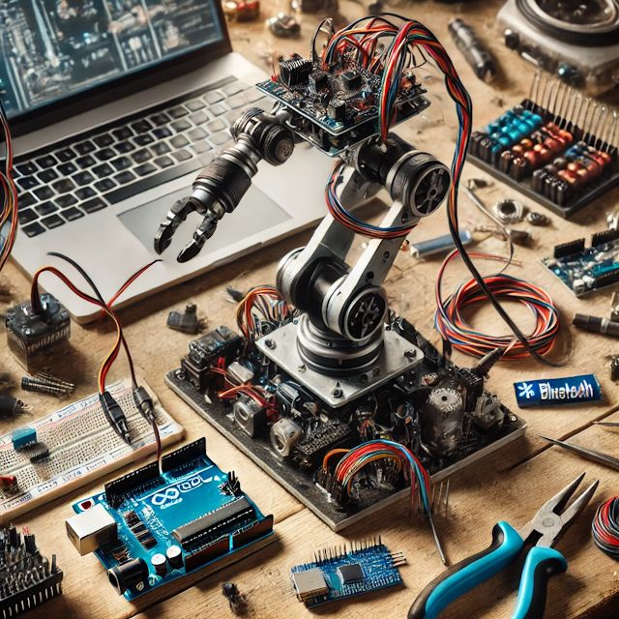
RESOURCE REQUIREMENTS
Hardware:
Robotic arm kit
Servo motors (MG996R Metal Gear Servo) - 6
Arduino Uno (R3)
Raspberry Pi 4 Model B
KY-023 2-Axis Analog Joystick Module
6 V 5000 mAh LiPo Battery Pack + UBEC Voltage Regulator
Software:
Arduino IDE
Python speech recognition tool (Vosk)

Slide 9
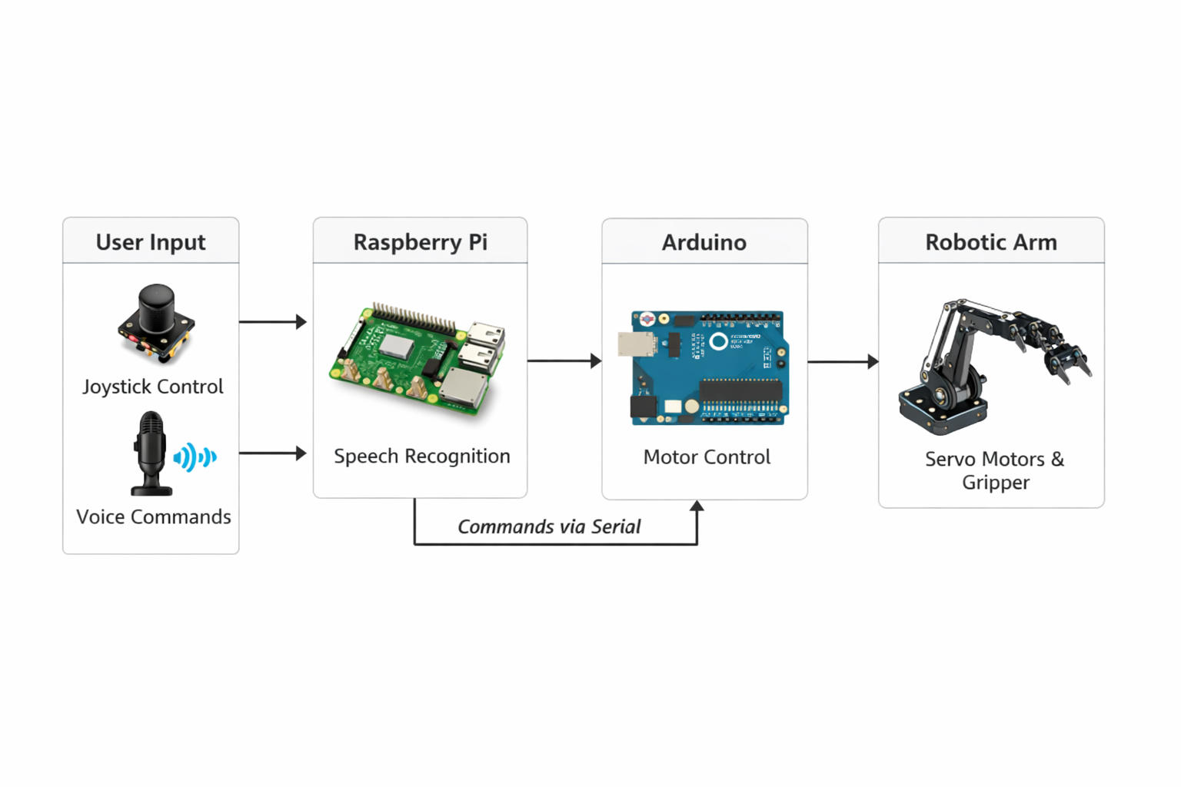
HIGH LEVEL BLOCK DIAGRAM

Slide 10
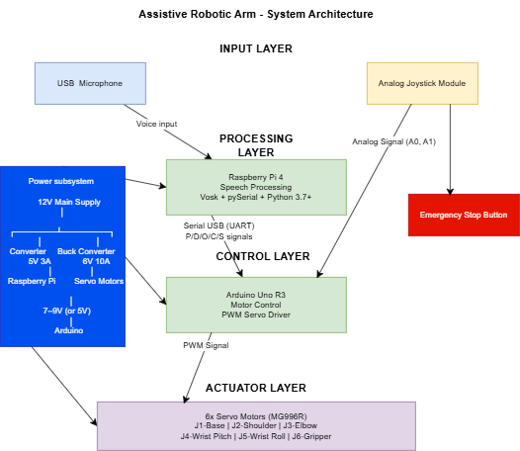
SYSTEM ARCHITECTURE

Slide 11
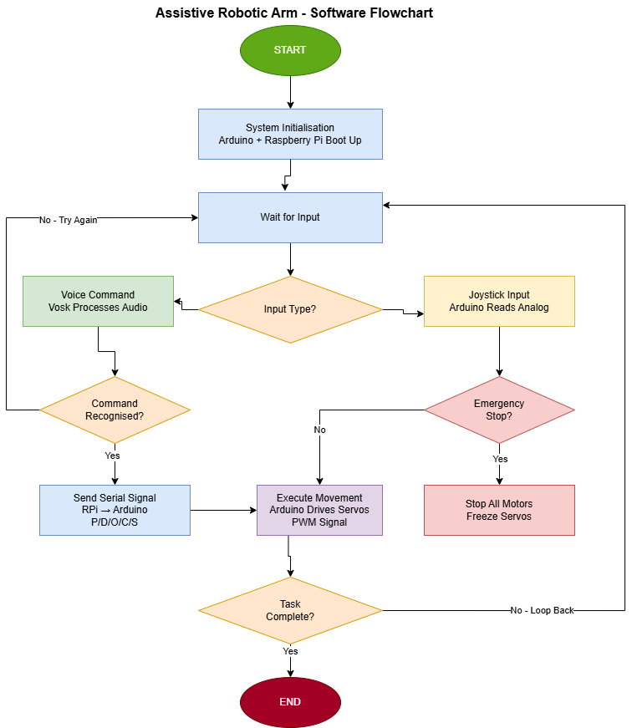
SYSTEM ARCHITECTURE

Slide 12
FUNCTIONAL REQUIREMENTS
Object Manipulation
Joystick-Based Control
Voice Command Recognition
Gripper Control

Slide 13
NON-FUNCTIONAL REQUIREMENTS
Safety: smooth motion, emergency stop
Usability: simple controls for impaired users
Reliability: consistent pick-and-place
Affordability: low-cost components

Slide 14

USE CASE SCENARIOS
Use Case 1: User moves joystick to pick object
Use Case 2: User says 'Pick' → arm grips object
Use Case 3: User says 'Drop' → arm releases object

Slide 15
CONSTRAINTS & ASSUMPTIONS
Constraints:
Table-top operation only
Limited budget and semester timeline
Assumptions:
User can give simple voice/joystick input
Objects are lightweight (<500g)

Slide 16

Must Have:
Basic arm movement + gripping
• Joystick control
Should Have:
Voice command control
Could Have:
ROS integration
Won’t Have:
Full AI vision tracking

Slide 17

TEAM RESPONSIBILITIES
Isaac Hevi: Mechanical assembly & wiring
Mohammed Ahmed: Arduino programming & joystick control
Kingsley Donkor Asare: Raspberry Pi voice system & integration

Slide 18
PROJECT TIMELINE
Week 1–2: Planning & research
Week 3: Arm assembly
Week 4: Servo motor control
Week 5: Joystick integration
Week 6–7: Pick-and-place automation
Week 8–9: Voice control
Week 10: Testing & final report

Slide 19
SUCCESS CRITERIA
Project will be successful if:
Arm picks and places objects reliably
Joystick control works smoothly
Voice commands trigger actions
System is safe and stable

Slide 20

SAFETY & ETHICAL CONSIDERATIONS
Prevent sudden movements
Ensure stable mounting
Respect user privacy in voice data
Device is a prototype, not medical-certified

Slide 21
NEXT STEPS
Finalize design requirements
Purchase components
Begin arm assembly
Start Arduino servo control development

